Slide 1
On Job Training Course
Java Persistence API (JPA)

Slide 2
Contents
Types of Mapping
JPA – Cascading
JPA – JPQL
JPQL Basic Operations
Sample Project

Slide 3
JPA - Type of Mapping
There are four types of mapping in JPA:
One-To-One Mapping
One-To-Many Mapping
Many-To-One Mapping
Many-To-Many Mapping

Slide 4
One-To-One Mapping
The One-To-One mapping represents a single-valued association where an instance
of one entity is associated with an instance of another entity. In this type of association one instance of source entity can be mapped atmost one instance of target entity.
In this example,
we will create a One-To-One relationship between a Student and Library in such a way that one student can be issued only one type of book.

Slide 5
One-To-One Mapping
Student.java
import javax.persistence.*;
@Entity
@Table(name = "student") public class Student {
@Id
private int sId;
private String sName; private int sAge;
//getter, setter
}

Slide 6
One-To-One Mapping
Library.java
import javax.persistence.*;
@Entity
public class Library { @Id
@GeneratedValue(strategy = GenerationType.AUTO)
private int bId;
private String bName; @OneToOne(cascade = CascadeType.ALL) private Student student;
//getter, setter
}

Slide 7
One-To-One Mapping
StoreStudLibrary.java
public class StoreStudLibrary { public static void main(String[] args) { EntityManagerFactory emf =
Persistence.createEntityManagerFactory("JPASampleProject"); EntityManager em = emf.createEntityManager(); em.getTransaction().begin();
Student st1 = new Student(); st1.setsId(105); st1.setsAge(20); st1.setsName("Jon"); Student st2 = new Student(); st2.setsId(106); st2.setsAge(22); st2.setsName("Smith");

Slide 8
One-To-One Mapping
Library lib1 = new Library(); lib1.setbId(1); lib1.setbName("Data Structure"); lib1.setStudent(st1);
Library lib2 = new Library(); lib2.setbId(2); lib2.setbName("DBMS"); lib2.setStudent(st2); em.persist(lib1); em.persist(lib2); em.getTransaction().commit(); em.close();
}
}

Slide 9
One-To-One Mapping
FindStudLibrary.java
public class FindStudLibrary {
public static void main(String args[]) { EntityManagerFactory emf =
Persistence.createEntityManagerFactory("JPASampleProject");
EntityManager em = emf.createEntityManager();
Library lib = em.find(Library.class, 1); System.out.println("Book Name : " + lib.getbName()); System.out.println("Student id = " + lib.getStudent().getsId());
System.out.println("Student Name = " + lib.getStudent().getsName());
em.close();
}
}

Slide 10
One-To-Many Mapping
The One-To-Many mapping comes into the category of collection-valued association where an entity is associated with a collection of other entities. Hence, in this type of association the instance of one entity can be mapped with any number of instances of another entity.
In this example,
we will create a One-To-Many relationship between a Student and Library in such a way that one student can be issued more than one type of book.

Slide 11

One-To-Many Mapping
OtMStudent.java
import javax.persistence.*;
@Entity
@Table(name = "otmstudent") public class OtMStudent { @Id
private int sId;
private String sName; private int sAge;
@OneToMany(cascade = CascadeType.ALL) private List<OtMLibrary> books_issued;
//getter, setter
}

Slide 12
One-To-Many Mapping
OtMLibrary.java
@Entity
@Table(name = "otmlibrary") public class OtMLibrary { @Id
@GeneratedValue(strategy = GenerationType.AUTO)
private int bId;
private String bName;
//getter, setter
}

Slide 13
One-To-Many Mapping
OtMStoreStudLibrary.java
public class OtMStoreStudLibrary { public static void main(String[] args) { EntityManagerFactory emf =
Persistence.createEntityManagerFactory("JPASampleProject"); EntityManager em = emf.createEntityManager(); em.getTransaction().begin();
List<OtMLibrary> lstBook = new ArrayList<OtMLibrary>(); OtMLibrary lib1 = new OtMLibrary();
lib1.setbId(101); lib1.setbName("Data Structure"); OtMLibrary lib2 = new OtMLibrary();
lib2.setbId(102); lib2.setbName("DBMS");

Slide 14
One-To-Many Mapping
lstBook.add(lib1); lstBook.add(lib2);
OtMStudent st1 = new OtMStudent();
st1.setsId(105); st1.setsAge(20); st1.setsName("Jon"); st1.setBooks_issued(lstBook);
OtMStudent st2 = new OtMStudent();
st2.setsId(106); st2.setsAge(22); st2.setsName("Smith"); st2.setBooks_issued(lstBook); em.persist(st1); em.persist(st2); em.getTransaction().commit(); em.close();
} }

Slide 15
Many-To-One Mapping
The Many-To-One mapping represents a single-valued association where a collection of entities can be associated with the similar entity. Hence, in relational database any more than one row of an entity can refer to the similar rows of another entity.
In this example,
we will create a Many-To-One relationship between a Student and Library in such a way that more than one student can issued the same book.

Slide 16
Many-To-One Mapping
MtOStudent.java
import javax.persistence.*;
@Entity
public class MtOStudent {
@Id
private int sId;
private String sName;
private int sAge;
@ManyToOne(cascade = CascadeType.ALL) private MtOLibrary lib;
//getter , setter
}

Slide 17
Many-To-One Mapping
MtOLibrary.java
import javax.persistence.*;
@Entity
public class MtOLibrary { @Id
@GeneratedValue(strategy = GenerationType.AUTO)
private int bId;
private String bName;
// getter, setter
}

Slide 18
Many-To-One Mapping
MtOStoreStudLibrary.java
public class MtOStoreStudLibrary { public static void main(String[] args) { EntityManagerFactory emf =
Persistence.createEntityManagerFactory("JPASampleProject"); EntityManager em = emf.createEntityManager(); em.getTransaction().begin();
MtOLibrary lib = new MtOLibrary();
lib.setbId(102); lib.setbName("DBMS");

Slide 19
Many-To-One Mapping
MtOStudent st1 = new MtOStudent(); st1.setsId(105);
st1.setsAge(22);
st1.setsName("Jon"); st1.setLib(lib);
MtOStudent st2 = new MtOStudent(); st2.setsId(106);
st2.setsAge(27);
st2.setsName("Smith"); st2.setLib(lib); em.persist(st1); em.persist(st2); em.getTransaction().commit(); em.close();
}
}

Slide 20
Many-To-Many Mapping
The Many-To-Many mapping represents a collection-valued association where any number of entities can be associated with a collection of other entities. In relational database any number of rows of one entity can be referred to any number of rows of another entity.
In this example,
we will create a Many-To-Many relationship between a Student and Library in such a way that any number of students can be issued any type of books.

Slide 21
Many-To-Many Mapping
MtMStudent.java
import javax.persistence.*; @Entity
public class MtMStudent { @Id
private int sId;
private String sName; private int sAge;
@ManyToMany(cascade = CascadeType.ALL) @JoinTable(name = "stud_lib", joinColumns = { @JoinColumn(name = "stud_id") }, inverseJoinColumns = {
@JoinColumn(name = "lib_id") }) private List<MtMLibrary> lib;
//getter , setter
}

Slide 22
Many-To-Many Mapping
MtMLibrary.java
import javax.persistence.*; @Entity
public class MtMLibrary { @Id
@GeneratedValue(strategy = GenerationType.AUTO) private int bId;
private String bName; @ManyToMany(mappedBy = "lib") private List<MtMStudent> student;
//getter, setter
}

Slide 23
Many-To-Many Mapping
MtMStoreStudLibrary.java
import java.util.*;
import javax.persistence.*; import com.jpa.model.*;
public class MtMStoreStudLibrary {
public static void main(String[] args) { EntityManagerFactory emf =
Persistence.createEntityManagerFactory("JPASampleProject"); EntityManager em = emf.createEntityManager(); em.getTransaction().begin();
List<MtMLibrary> lstLib1 = new ArrayList<MtMLibrary>(); List<MtMLibrary> lstLib2 = new ArrayList<MtMLibrary>();

Slide 24
Many-To-Many Mapping
MtMLibrary lib1 = new MtMLibrary(); lib1.setbId(101); lib1.setbName("Data Structure");
MtMLibrary lib2 = new MtMLibrary(); lib2.setbId(102); lib2.setbName("DBMS");
MtMLibrary lib3 = new MtMLibrary(); lib3.setbId(103); lib3.setbName("Artificial Intelligence");
lstLib1.add(lib1); lstLib1.add(lib2); lstLib2.add(lib2); lstLib2.add(lib3);

Slide 25
Many-To-Many Mapping
MtMStudent st1 = new MtMStudent(); st1.setsId(105);
st1.setsAge(22); st1.setsName("Jon"); st1.setLib(lstLib1);
MtMStudent st2 = new MtMStudent(); st2.setsId(106);
st2.setsAge(27); st2.setsName("Smith"); st2.setLib(lstLib2); em.persist(st1);
em.persist(st2); em.getTransaction().commit(); em.close();
}
}

Slide 26
JPA - Cascading
In JPA, if any operation is applied on an entity then it will perform on that particular entity only. These operations will not be applicable to the other entities that are related to it.
To establish a dependency between related entities, JPA provides javax.persistence.CascadeType enumerated types that define the cascade operations.
These cascading operations can be defined with any type of mapping i.e. One-to-One, One-to-Many, Many-to-One, Many-to-Many.

Slide 27
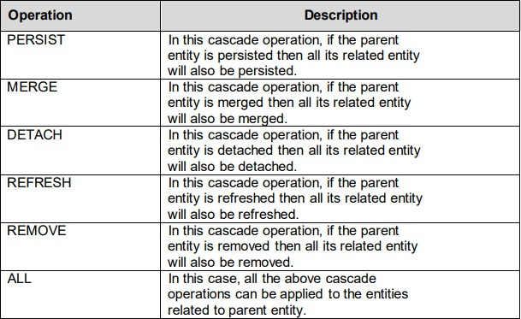
JPA - Cascading

Slide 28
JPA - JPQL
The JPQL (Java Persistence Query Language) is an object-oriented query language which is used to perform database operations on persistent entities.
Instead of database table, JPQL uses entity object model to operate the SQL
queries.
Here, the role of JPA is to transform JPQL into SQL. Thus, it provides an easy platform for developers to handle SQL tasks.
JPQL is an extension of Entity JavaBeans Query Language (EJBQL), adding the following important features to it: -
It can perform join operations.
It can update and delete data in a bulk.
It can perform aggregate function with sorting and grouping clauses.
Single and multiple value result types.

Slide 29
JPQL Features
It is a platform-independent query language.
It is simple and robust.
It can be used with any type of database such as MySQL, Oracle.
JPQL queries can be declared statically into metadata or can also be
dynamically built in code.

Slide 30
Creating Queries in JPQL
JPQL provides two methods that can be used to access database records. These
methods are: -
Query createQuery(String name) - The createQuery() method of EntityManager interface is used to create an instance of Query interface for executing JPQL statement.
Query createNamedQuery(String name) - The createNamedQuery() method of EntityManager interface is used to create an instance of Query interface for executing named queries.

Slide 31
JPQL Basic Operations
Student.java
import javax.persistence.*; @Entity
@Table(name = "student") public class Student {
@Id
private int sId;
private String sName; private int sAge;
// getter, setter
}

Slide 32
JPQL Basic Operations
FetchColumn.java
public class FetchColumn {
public static void main(String args[]) {
EntityManagerFactory emf = Persistence.createEntityManagerFactory("JPASampleProject"); EntityManager em = emf.createEntityManager();
Query query = em.createQuery("Select s.sName from Student s");
List<String> list = query.getResultList();
System.out.println("Student Name :"); for (String s : list) { System.out.println(s);
}
em.close();
}
}

Slide 33
JPQL Static Query
Student.java
import javax.persistence.*;
@Entity
@Table(name = "student")
@NamedQuery(name = "findName" , query = "Select s.sName from Student s") public class Student {
@Id
private int sId;
private String sName; private int sAge;
//getter, setter
}
Replace with the following code in the FetchColumn.java
Query query = em.createNamedQuery("findName");

Slide 34
JPQL Bulk Data Operations
FindAllStudent.java
import java.util.List;
import javax.persistence.*;
import com.jpa.model.Student; public class FindAllStudent {
public static void main(String args[]) { EntityManagerFactory emf =
Persistence.createEntityManagerFactory("JPASampleProject");
EntityManager em = emf.createEntityManager();
List<Student> lstStudent = em.createQuery("select s from Student s").getResultList(); for (int i = 0; i < lstStudent.size(); i++) {
System.out.println(lstStudent.get(i).getsId()); System.out.println(lstStudent.get(i).getsName());
} em.close();
} }

Slide 35
JPQL Update
JPQLUpdateStudent.java import javax.persistence.*; import com.jpa.model.Student;
public class JPQLUpdateStudent { public static void main(String args[]) { EntityManagerFactory emf =
Persistence.createEntityManagerFactory("JPASampleProject");
EntityManager em = emf.createEntityManager();
em.getTransaction().begin();
Query query = em.createQuery("update Student SET sAge=:age where sId>:id"); query.setParameter("age",30);
query.setParameter("id", 105);
query.executeUpdate(); em.getTransaction().commit(); em.close();
} }

Slide 36
JPQL Delete
JPQLDeleteLibrary.java import javax.persistence.*; import com.jpa.model.Library; import com.jpa.model.Student;
public class JPQLDeleteLibrary { public static void main(String args[]) { EntityManagerFactory emf =
Persistence.createEntityManagerFactory("JPASampleProject");
EntityManager em = emf.createEntityManager(); em.getTransaction().begin();
Library lib=em.find(Library.class, 2); Student s=lib.getStudent();
lib.setStudent(null);
em.remove(s); em.getTransaction().commit(); em.close();
} }

Slide 37
Sample Project with JPA
To integrate JPA with Spring MVC, the following steps are required to do :
Step -1 : Project – Dynamic Web Project
Step -2 : Add jar files of (Spring MVC, JPA EclipseLink) The following steps are the same in the Spring MVC project.
In this example, we show JPA with Dynamic Web Project
(BookManagementSystem).
Let’s start Spring MVC with JPA integration.

Slide 38
Sample Project with JPA
1. web.xml
<display-name>JPASpringBook_20200916</display-name>
<servlet>
<servlet-name>spring</servlet-name>
<servlet-class> org.springframework.web.servlet.DispatcherServlet
</servlet-class>
</servlet>
<servlet-mapping>
<servlet-name>spring</servlet-name>
<url-pattern>/</url-pattern>
</servlet-mapping>

Slide 39
Sample Project with JPA
2. spring-servlet.xml
<bean id="ld"
class= "org.springframework.instrument.classloading.InstrumentationLoadTimeWeaver" />
<context:load-time-weaver />
<bean id="jpaVendor" class="org.springframework.orm.jpa.vendor.EclipseLinkJpaVendorAdapter">
<property name="showSql" value="true" />
<property name="generateDdl" value="true" />
<property name="database" value="MYSQL" />
</bean>

Slide 40
Sample Project with JPA
<bean id="emf" class="org.springframework.orm.jpa.LocalContainerEntityManagerFactoryBean">
<property name="loadTimeWeaver" ref="ld" />
<property name="dataSource" ref="ds" />
<property name="jpaVendorAdapter" ref="jpaVendor"></property>
<property name="persistenceUnitName"
value="JPASpringBook_20200916" />
<property name="packagesToScan">
<list>
<value>com.book.model</value>
</list>
</property>
</bean>

Slide 41
Sample Project with JPA
<bean id="myTxManager" class="org.springframework.orm.jpa.JpaTransactionManager">
<property name="entityManagerFactory" ref="emf" />
<property name="dataSource" ref="ds" />
</bean>
<tx:annotation-driven transaction-manager="myTxManager" />

Slide 42
Sample Project with JPA
3. Book.java
@Entity
public class Book { @Id
private String bookCode; private String bookTitle; private String bookAuthor; private String bookPrice;
//getter, setter
}

Slide 43
Sample Project with JPA
4. BookDao Interface
public interface BookDao {
public int insertData(Book book); public int updateData(Book book);
public int deleteData(String bookCode);
public Book selectOne(String bookCode); public List<Book> selectAll();
}

Slide 44
Sample Project with JPA
5. BookDaoImpl.java
@Component
public class BookDaoImpl implements BookDao { @PersistenceContext
private EntityManager em; @Transactional @Override
public int insertData(Book book) { try {
em.persist(book);
} catch (Exception e) { System.out.println(e.getMessage()); return 0;
}
return 1;
}

Slide 45
Sample Project with JPA
@Transactional @Override
public int updateData(Book book) { Query query = em.createQuery(
"UPDATE Book b SET b.bookTitle = :bookTitle, b.bookAuthor =:bookAuthor , b.bookPrice =:bookPrice WHERE b.bookCode =:bookCode"); query.setParameter("bookTitle", book.getBookTitle()); query.setParameter("bookAuthor", book.getBookAuthor()); query.setParameter("bookPrice", book.getBookPrice()); query.setParameter("bookCode", book.getBookCode());
int i = query.executeUpdate();
return i;
}

Slide 46
Sample Project with JPA
@Transactional @Override
public int deleteData(String bookCode) {
Query query = em.createQuery("DELETE FROM Book b WHERE b.bookCode
=:bookCode"); query.setParameter("bookCode", bookCode); int i = query.executeUpdate();
return i;
}
@Override
public Book selectOne(String bookCode) {
Book book = em.createQuery("SELECT b FROM Book b WHERE b.bookCode
=:bookCode", Book.class).setParameter("bookCode", bookCode).getSingleResult(); return book;
}

Slide 47
Sample Project with JPA
@Override
public List<Book> selectAll() {
List<Book> lstBook = em.createQuery("SELECT b FROM Book b",
Book.class).getResultList();
return lstBook;
}
}

Slide 48
Sample Project with JPA
6. BookController.java
@Controller
public class BookController { @Autowired
BookDao bookDao;
@RequestMapping(value = "/", method = RequestMethod.GET) public String displayView(ModelMap model) {
List<Book> list = bookDao.selectAll();
model.addAttribute("list", list); return "displaybook";
}
@RequestMapping(value = "/setupaddbook", method = RequestMethod.GET) public ModelAndView setupaddBook() {
return new ModelAndView("addbook", "bean", new Book());
}

Slide 49
Sample Project with JPA
@RequestMapping(value = "/addbook", method = RequestMethod.POST) public String addBook(@ModelAttribute("bean") Book bean,
ModelMap model) {
int res = bookDao.insertData(bean);
if (res == 0) {
model.addAttribute("error", "Insert Failed"); return "addbook";
}
return "redirect:/";
}
@RequestMapping(value = "setupupdateBook/{bookCode}", method = RequestMethod.GET)
public ModelAndView setupUpdate(@PathVariable String bookCode) { return new ModelAndView("updatebook", "bean", bookDao.selectOne(bookCode));
}

Slide 50
Sample Project with JPA
@RequestMapping(value = "/updatebook", method = RequestMethod.POST) public String updateBook(@ModelAttribute("bean") Book bean, ModelMap model) {
int res = bookDao.updateData(bean);
if (res == 0) {
model.addAttribute("error", "Update Failed"); return "updatebook";
}
return "redirect:/";
}
@RequestMapping(value = "deleteBook/{bookCode}", method = RequestMethod.GET)
public String deleteBook(@PathVariable String bookCode, ModelMap model) { int res = bookDao.deleteData(bookCode);
if (res == 0) {
model.addAttribute("error", "Delete Failed"); return "redirect:/";
}
return "redirect:/";
} }

Slide 51
Sample Project with JPA
7. header.jsp
<body>
<h3> Book Management</h3>
<a href="/JPASpringBook_20200916/setupaddbook"> Add New Book
</a>&nbsp;&nbsp;&nbsp;
<a href="/JPASpringBook_20200916/"> Show All Book
</a>
</body>

Slide 52
Sample Project with JPA
8. displaybook.jsp
<style>
table, th, td {
border: 1px solid blue; border-collapse: collapse;
}
</style>
</head>
<body>
<center>
<jsp:include page="header.jsp"></jsp:include>
<br />
<div style="color: blue;">${msg}</div>
<div style="color: red;">${error}</div>
<br />

Slide 53
Sample Project with JPA
<table>
<tr>
<th>Book Code</th>
<th>Book Title</th>
<th>Book Author</th>
<th>Book Price</th>
<th>Action</th>
</tr>
<c:forEach items="${list}" var="data">
<tr>
<td>${data.bookCode}</td>
<td>${data.bookTitle}</td>
<td>${data.bookAuthor}</td>
<td>${data.bookPrice}</td>
<td><a href="setupupdateBook/${data.bookCode}">Update</a> <a href="deleteBook/${data.bookCode}">Delete</a></td>
</tr>
</c:forEach>
</table> </center> </body>

Slide 54
Sample Project with JPA
9. addbook.jsp
<body>
<center>
<jsp:include page="header.jsp"></jsp:include>
<br />
<form:form action="/JPASpringBook_20200916/addbook" method="post"
modelAttribute="bean">
<table>
<tr>
<td>Book Code</td>
<td><form:input type="text" path="bookCode" /></td>
</tr>
<tr>
<td>Book Title</td>
<td><form:input type="text" path="bookTitle" /></td>
</tr>

Slide 55
Sample Project with JPA
<tr>
<td>Book Author</td>
<td><form:input type="text" path="bookAuthor" /></td>
</tr>
<tr>
<td>Book Price</td>
<td><form:input type="text" path="bookPrice" /></td>
</tr>
<tr>
<td></td>
<td><input type="submit" value="Save" /></td>
</tr>
</table>
</form:form>
</center>
</body>

Slide 56
Sample Project with JPA
10. updatebook.jsp
<body>
<center>
<jsp:include page="header.jsp"></jsp:include>
<br />
<form:form action="/JPASpringBook_20200916/updatebook" method="post"
modelAttribute="bean">
<table>
<tr>
<td>Book Code</td>
<td><form:input type="text" path="bookCode" /></td>
</tr>
<tr>
<td>Book Title</td>
<td><form:input type="text" path="bookTitle" /></td>
</tr>

Slide 57
Sample Project with JPA
<tr>
<td>Book Author</td>
<td><form:input type="text" path="bookAuthor" /></td>
</tr>
<tr>
<td>Book Price</td>
<td><form:input type="text" path="bookPrice" /></td>
</tr>
<tr>
<td></td>
<td><input type="submit" value="UpdateBook" /></td>
</tr>
</table>
</form:form>
</center>
</body>

Slide 58
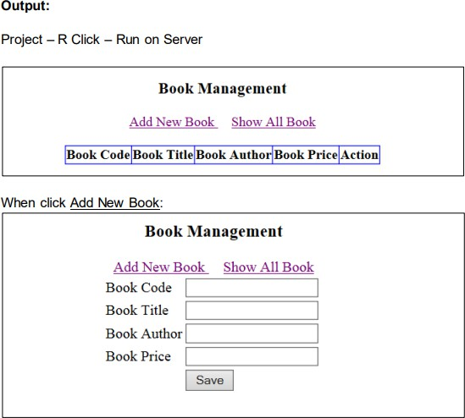
Sample Project with JPA

Slide 59
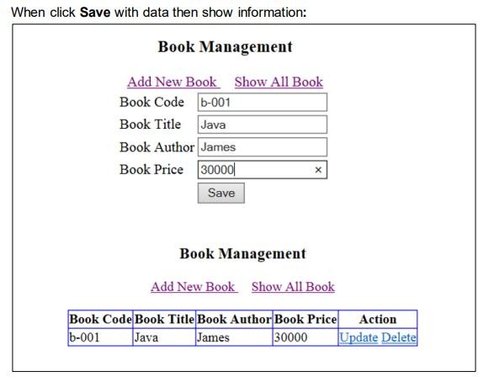
Sample Project with JPA

Slide 60
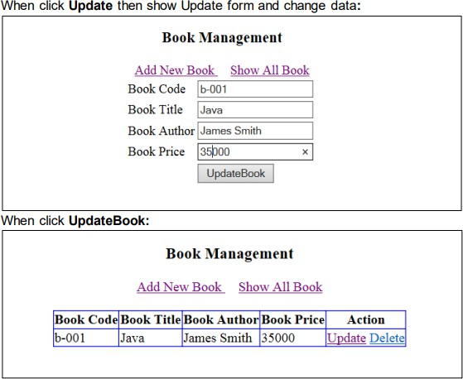
Sample Project with JPA

Slide 61
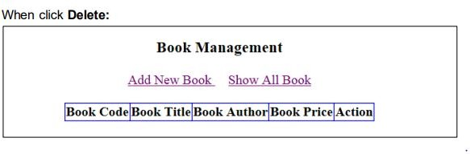
Sample Project with JPA

Slide 62
Thank you!! Q&As

Slide 63
References
https://www.baeldung.com/learn-jpa-hibernate
https://www.javaguides.net/p/jpa-tutorial-java-persistence-api.html
https://www.mygreatlearning.com/jpa/tutorials/
https://medium.com/jpa-java-persistence-api-guide

